Slide 1

Eclipse Installation and usage
Tips, Techniques, and Best Practices

Slide 2
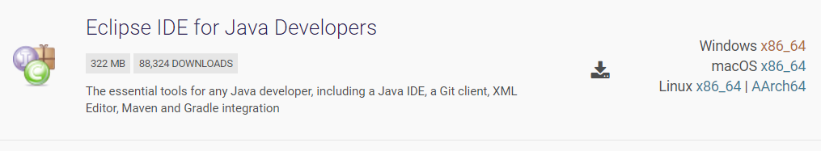
Step 1. Download Eclipse
Go to the link https://www.eclipse.org/downloads/packages/
Download “Eclipse IDE for Java Developers”.
Please ensure that you are selecting the correct link (eg: if you are using Windows machine, then chose Windows link)

Slide 3
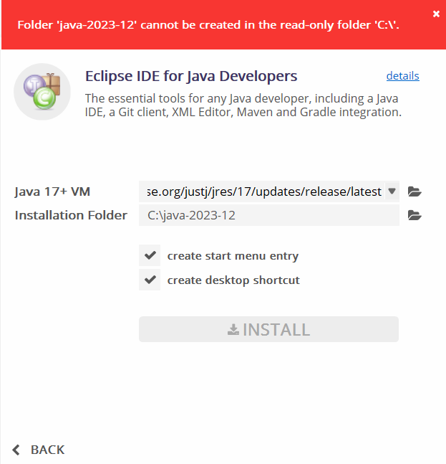
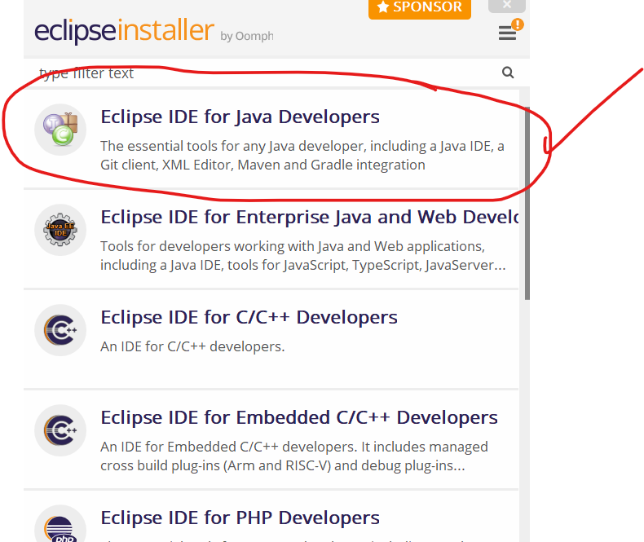
Step 2. Extract the downloaded ZIP file
Downloading will bring you an exe file (typically, this goes into Downloads folder on Windows)

Slide 4
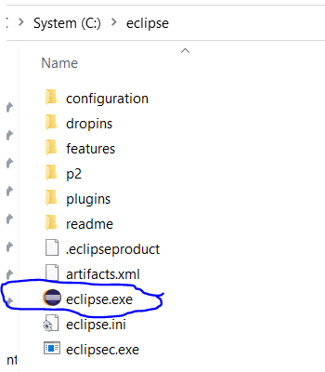
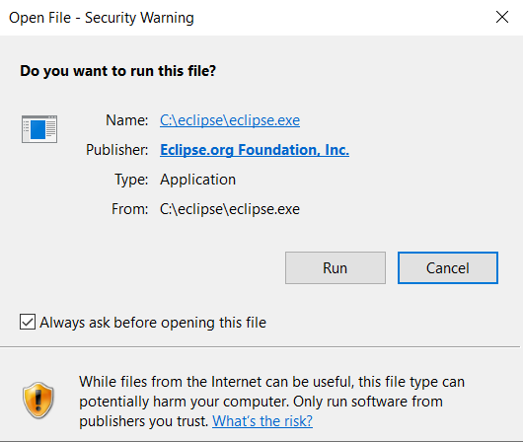
Step 3. Launch Eclipse
Go to the directory where you installed Eclipse (e.g. C:\eclipse)
Locate the file “eclipse.exe”
Double-click it to launch Eclipse.

Slide 5
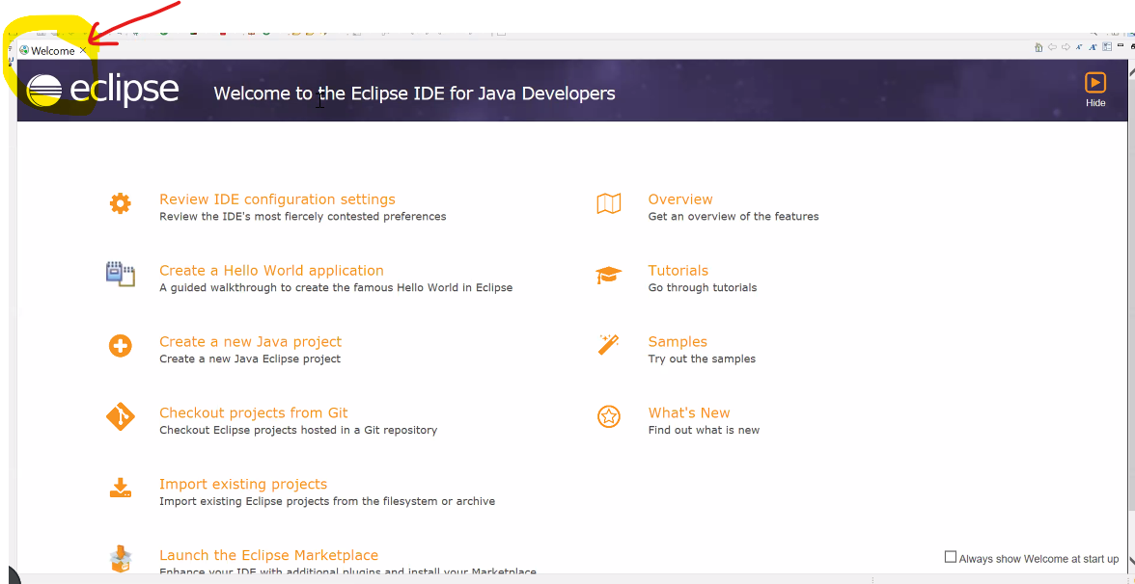
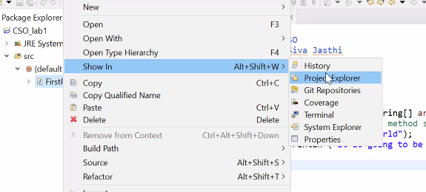
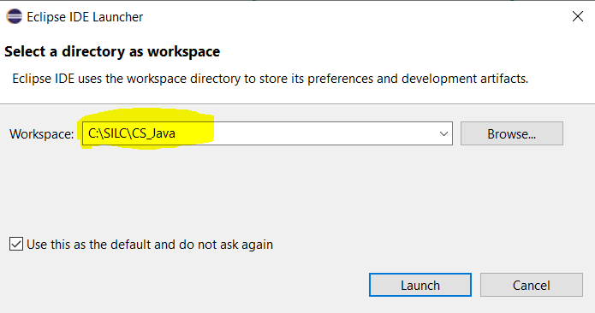
Step 4. Specify the workspace
Workspace is a place where Java keeps all your projects.
Specify the Workspace directory (for example: “C:\SILC\CS_Java”)
Check the box “Use this as the default and do not ask again”. Eclipse won’t bother you again when you launch Eclipse.

Slide 6
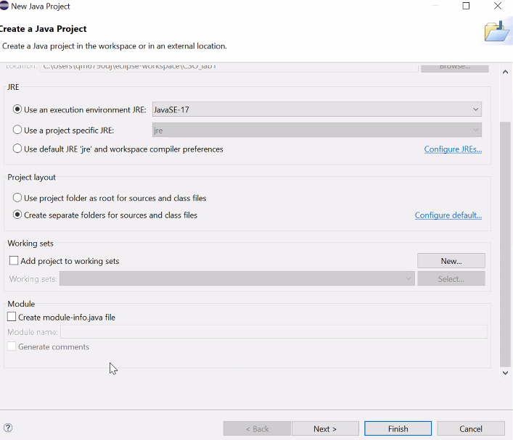
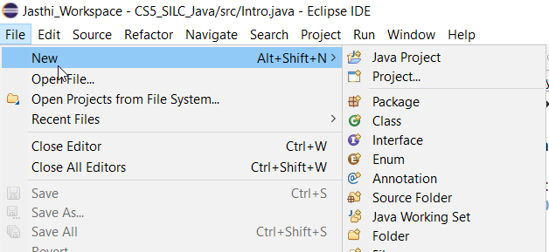
Step 5. Create a project
Steps 1,2,3 and 4 are one time tasks.
However, you will be doing Step 5 each time you want to start a new project.
Creating a Project: File → New → Java Project
Give a Project Name
Click “Finish”.
Don’t create the module file

Slide 7
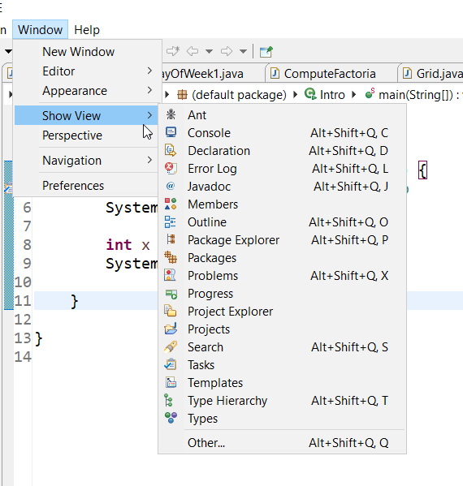
Step 5. Create a project (contd.)
Project Explorer showing the project you just created should be visible on the Left Hand Side navigation bar.
If it is not showing up, you can do “Window → Show View → Project Explorer” to see the project

Slide 8
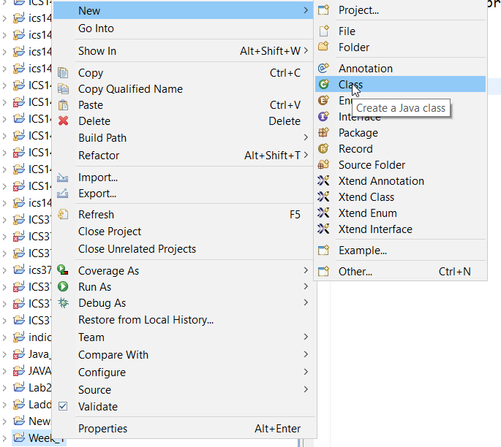
Step 6. Create a class
Once you create a project, then you can add 1 or more classes to that project.
While creating a class, you should be in the context of a Project.
Though you can create a class from the File menu, my preference is to create it through context-specific menu.
Select the Project → (right-click) for the context menu → New → Class

Slide 9
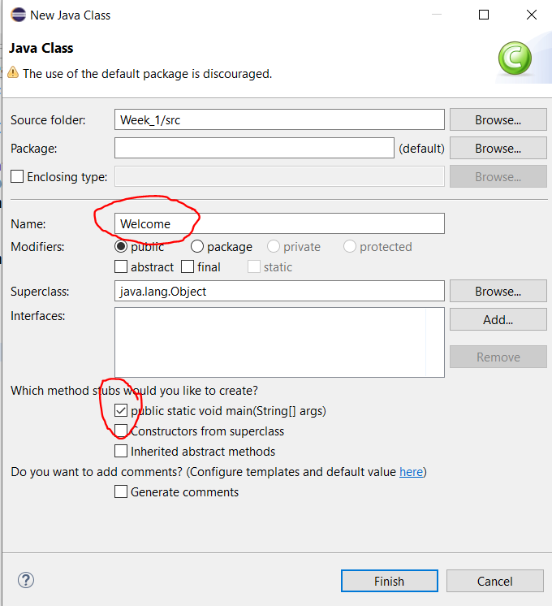
Step 6. Create a class (Cond.)
Per java coding conventions, java classes start with upper case.
Give a class name.
Also check “public static void main(String[] args)” option
Click “Finish” to create your first java class.

Slide 10
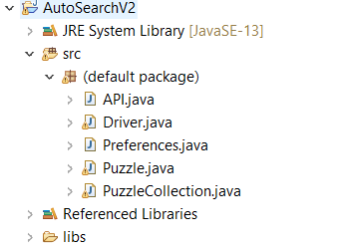
Anatomy of a Java Project in Eclipse Fix
This is the anatomy of your java project in Eclipse.
You can create as many Java projects as you want
You can create as many java classes as you want within each project.
Explore the folders in Eclipse.
Work Space
Java Project
[Package / default]
JRE System Library/
src/
A.java
B.java
Referenced Libraries/
Libs

Slide 11
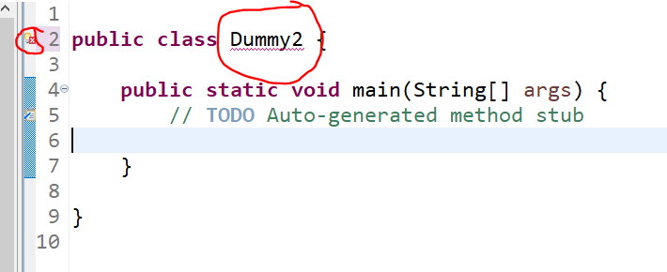
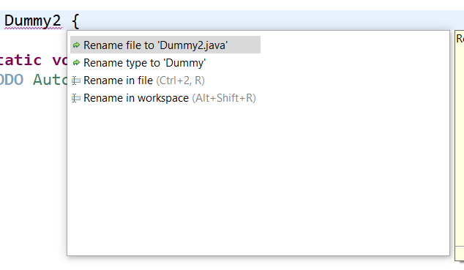
Tip 1: Eclipse Quick Fix (Ctrl + 1)
Ctrl + 1 (Windows)
Cmd + 1 (Mac)

Slide 12
Tip 2: Format Code
Ctrl + Shift + F

Slide 13
Tip 3: Organize Imports
Ctrl + Shift + O

Slide 14
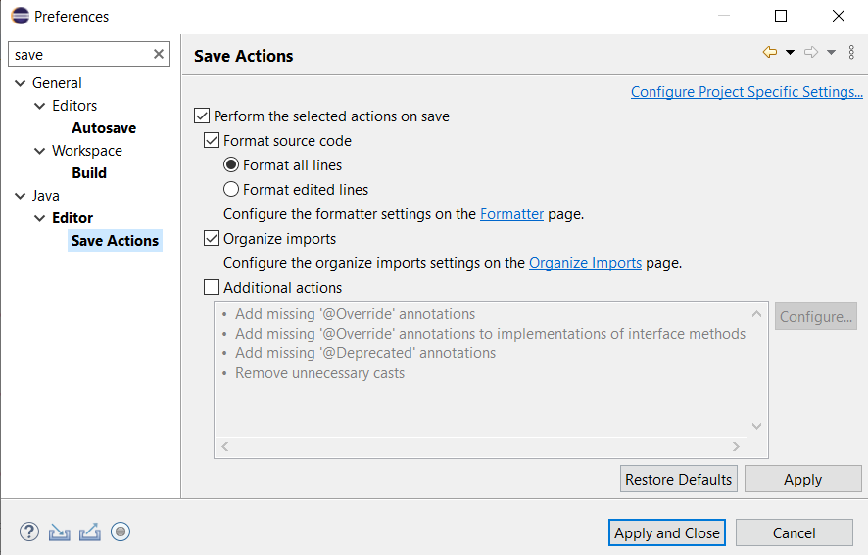
Tip 4: Auto-format on Save
Windows > Preferences > Java > Editor > Save Actions
(or search for “save” in the preferences)
Check [x] Format Source Code

Slide 15
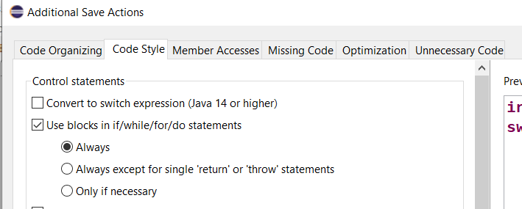
Tip 5: Always use “blocks” in if/while/for/do statements
Windows > Preferences > Java > Save Actions > Additional Actions > Code Style > Use blocks
Chose “Always”

Slide 16
Tip 6: Copying a snippet of code
Let us say you have found a snippet of code.
You want to try that out in your project.
Option 1: See the java class name; Create a class name with the same name; paste the code.
Option 2: Simply paste the code in src. Eclipse automatically creates the class for you.
Let us try pasting the code on how to take the user inputs in java
“https://www.w3schools.com/java/java_user_input.asp”

Slide 17
Tip 7: Create multiple classes in one go. (Extension of previous tip).
Paste the following code in src folder
public class A { }
public class B { }
public class StringSplitter{ }
public class CharacterMapper{ }

Slide 18
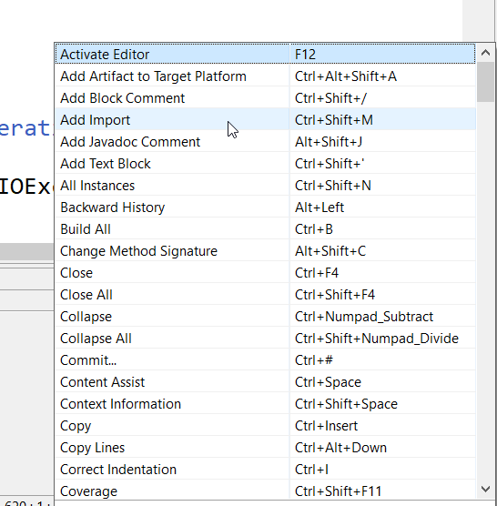
Tip 8: Shortcuts, Shortcuts, Shortcuts everywhere
Some important (commonly used) shortcuts
F3 > declaration (or definition)
F4 > Type Hierarchy
All 103 Eclipse Shortcuts
https://edisciplinas.usp.br/pluginfile.php/3257857/mod_resource/content/1/atalhos_eclipse.pdf
Ctrl + Shift + L = List all short cuts

Slide 19

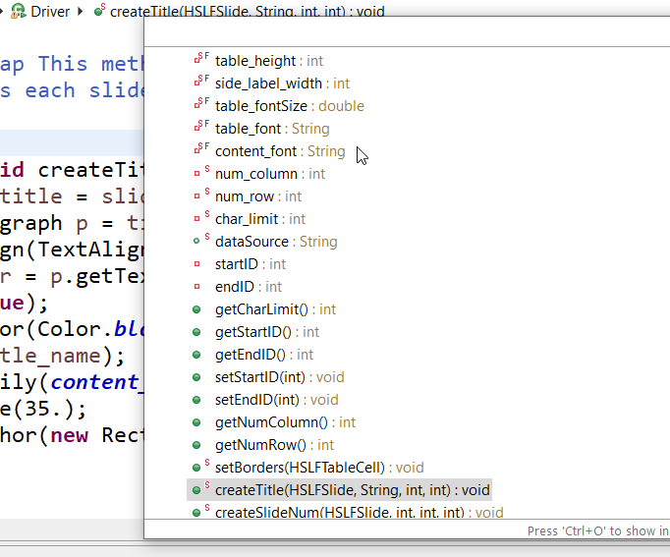
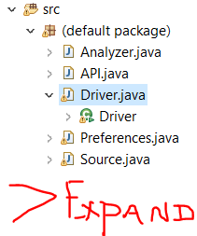
Tip 9: See the method and variables of a class
How to see the methods and variables of a given class?
Or press “Ctrl + O” to see all.
(And you can also filter the

Slide 20
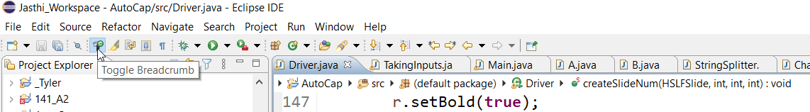
Tip 10: Breadcrumb
How to see the source/path of a class or method or variable?
You can toggle the “Breadcrumb” on (to see) or off (to hide)

Slide 21
Tip 11: Increase the font
Sometimes, you may want to increase the font of the editor (especially during the demos or walk-through of your code).
The tiny font may not be visible to all.
You can simply do
“Ctrl ++” (to increase the font)
“Ctrl –” (to decrease the font.
This is temporary font change.
If you want to do permanent font setting for your editor, you can do that in preferences (see next slide)

Slide 22
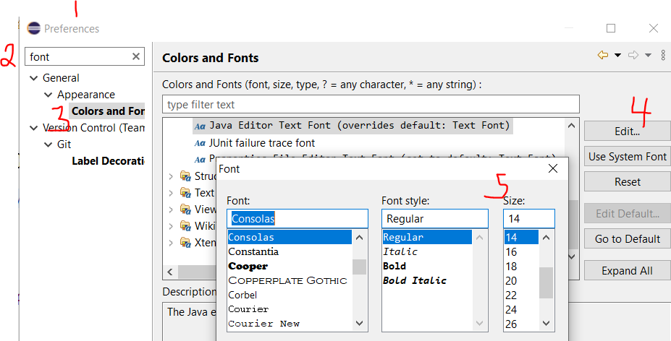
Tip 12: Set the Font type and size for your editor
Window>Preferences > search (Font) > Colors and Fonts > Edit.. > Set (Font, Style, Size)

Slide 23
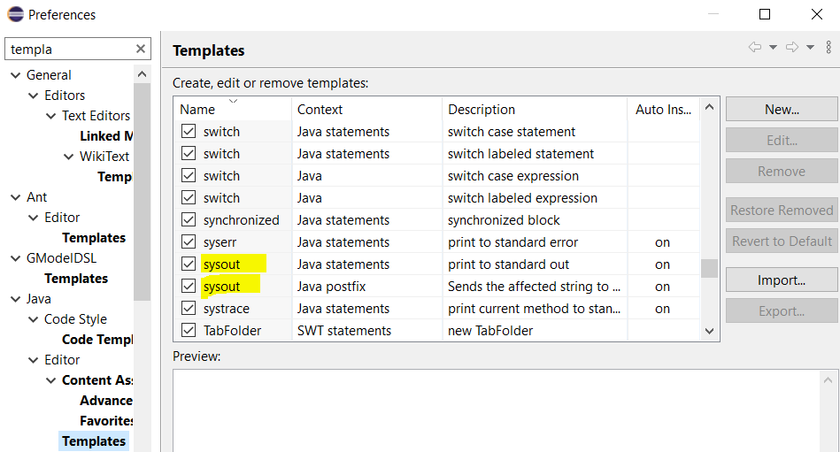
Tip 13: Templates (typing shortcuts)
Content Assist (Ctrl + Space)
Example: main
Example: sysout
Example: switch
How does java know? How do you define new ones?
Windows > preferences > search (template) > Java > Templates

Slide 24
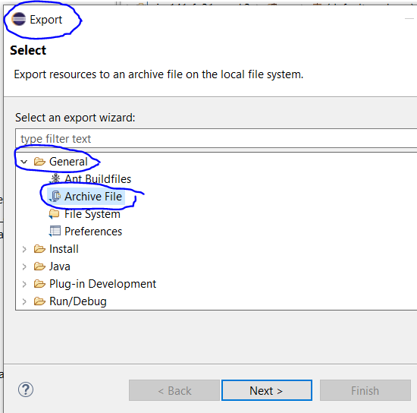
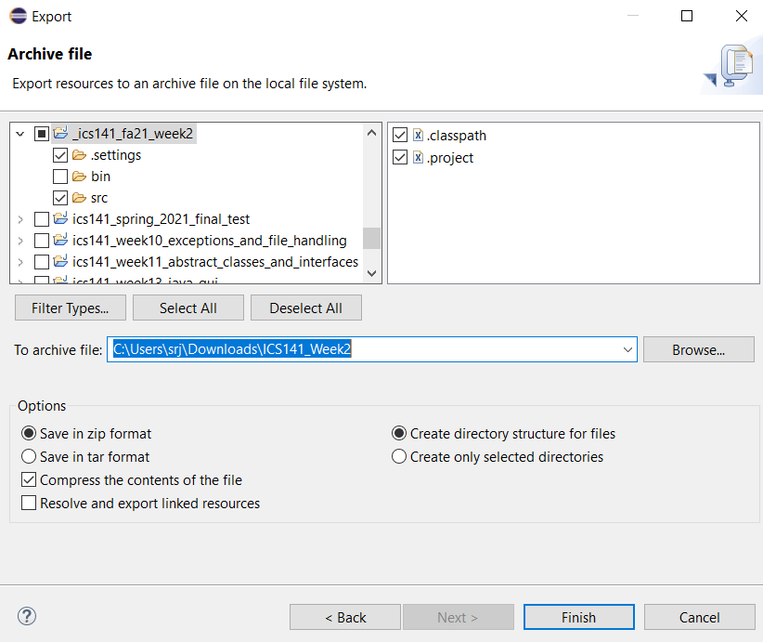
Tip 14: Exporting and Importing projects
Some projects may be referring to many external libraries.
And your project may also have complex package structure (where source files are kept in a deeper folder hierarchy).
You can export the project from Eclipse. The exported file contains all the settings & files needed to restore the project.
Select Project and Right-Click to get the context menu
Export > General > Archive File
You can exclude BIN folder
Save as ZIP file
And exported project can be imported back into Eclipse (by you or by others).
Import
Existing Projects in Eclipse
Chose the ZIP file for import
Please see this video
https://www.youtube.com/watch?v=NMfIHuEwE7A

Slide 25
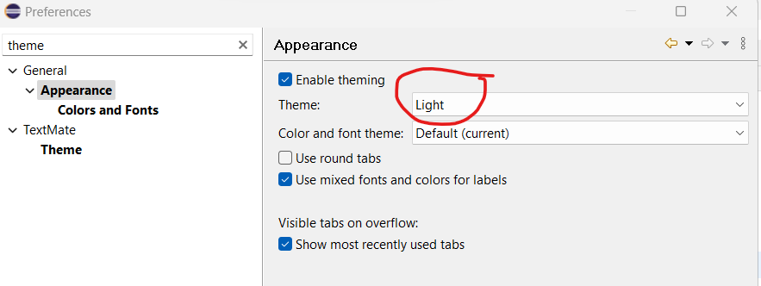
Tip 15: How to change the color theme?
Window → Preferences

Slide 26
Any questions?

